Slide 1
FALL 2013
CLASSIFIED
CONVOCATION
AUGUST 1, 2013

Slide 2
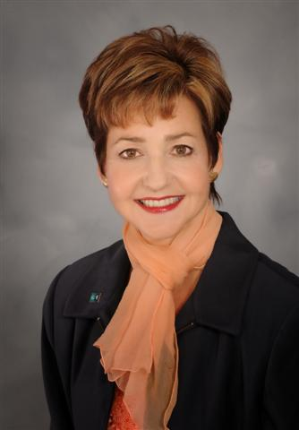
CHANCELLOR’S REMARKS
Cindy L. Miles, Ph.D.

Slide 3
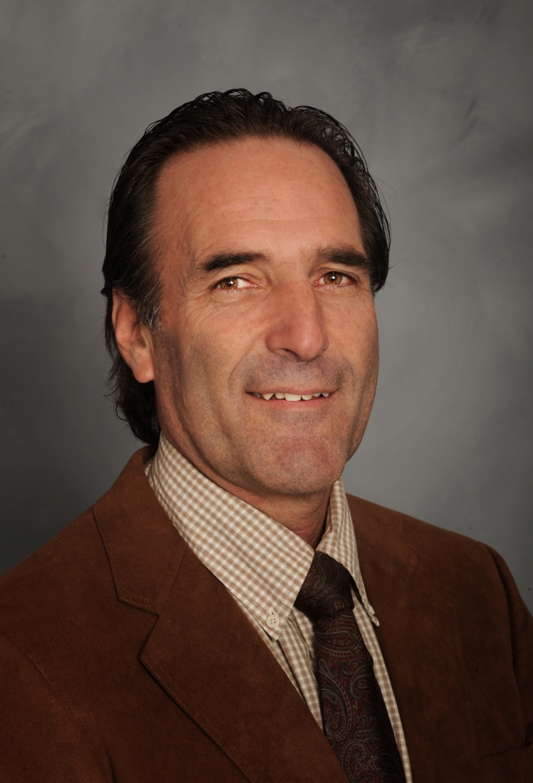
TRUSTEE’S REMARKS
EDWIN HIEL

Slide 4
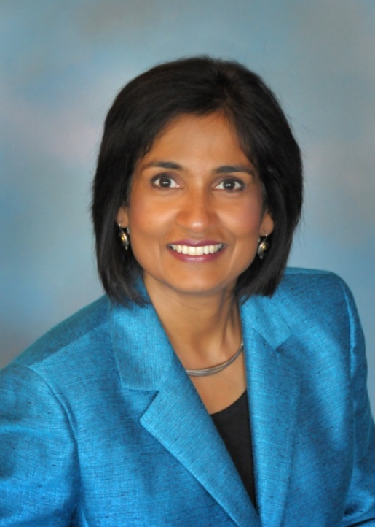
MESSAGE OF WELCOME
Sunita V. Cooke, Ph.D.
President
'Kid President,' The 'Self-Appointed Voice Of A Generation'

Slide 5
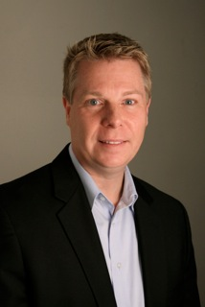
THE FOUNDATION FOR GROSSMONT & CUYAMACA COLLEGES
Glenn Kaufhold
President

Slide 6
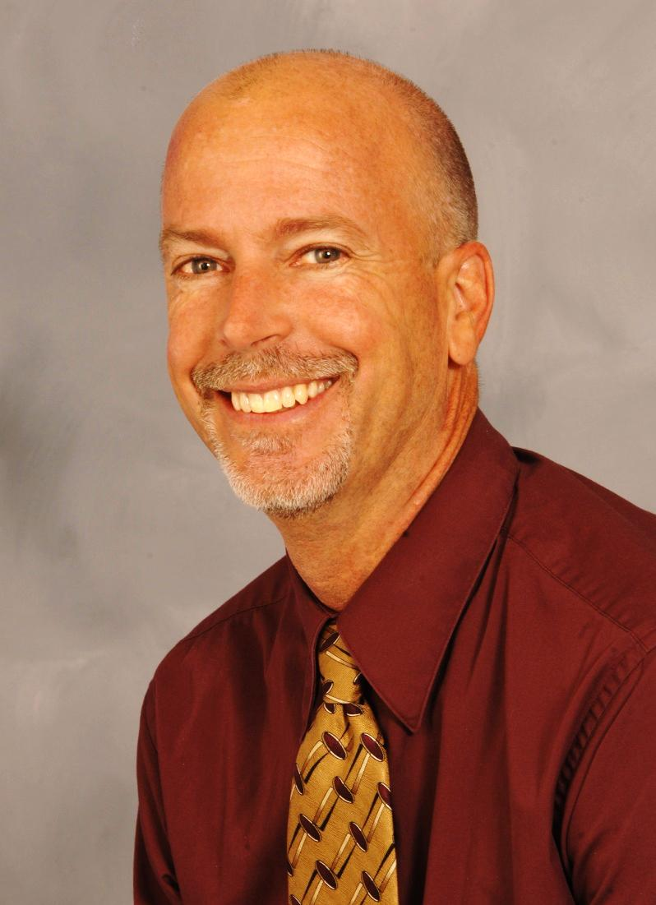
VICE PRESIDENT’S REMARKS

Slide 7
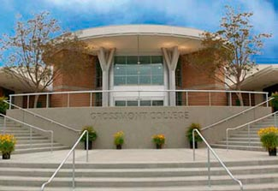
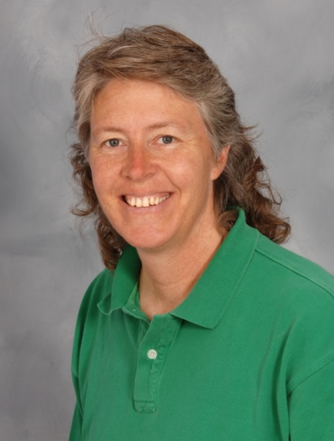
Accreditation: What's it all about?
Chris Hill
Accreditation Co-Chair

Slide 8
WHY IS ACCREDITATION IMPORTANT?
Value to the institution
Assures public that we meet standards of quality
Education and credentials earned are legitimate and of value
Meets federal requirements
Allows us to qualify for federal grants and contracts
Allows us to distribute financial aid

Slide 9
WHAT ARE WE ACCOUNTABLE FOR?
Four Standards
Standard I: Institutional Mission and Effectiveness
Standard II: Student Learning Programs and Services
Standard III: Resources
Standard IV: Governance
Rubrics – self-assess our level of proficiency
Planning
Program Review
Student Learning Outcomes

Slide 10
GC ACCREDITATION WRITING TEAM STRUCTURE
Accred Steering Comm
I
Inst Miss/Effect
IIA
Instr Prog
IV
Leader/Gover
IIID
Finan
Res
IIIC
Tech Res
IIIB
Phys Res
IIIA
Human Res
IIC
Lib/Learn Supp Svcs
IIB
Stud Supp Svcs
Notes:
Chris starts here

Slide 11
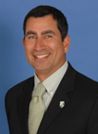
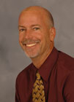
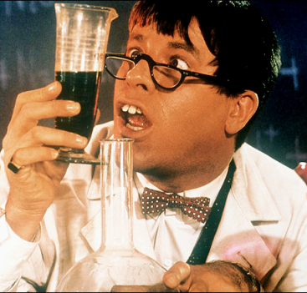
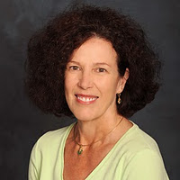
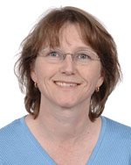
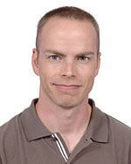
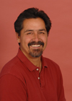
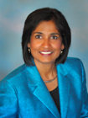
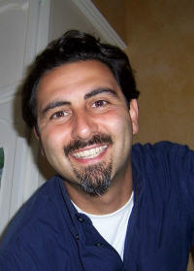
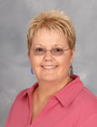
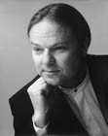
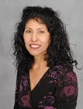
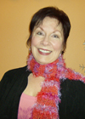
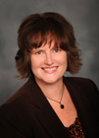
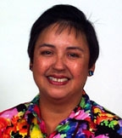
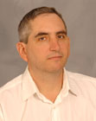
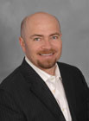
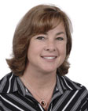
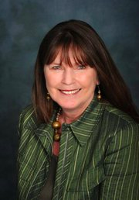
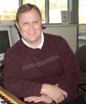
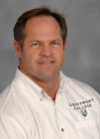
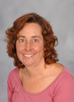
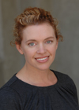
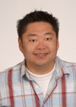
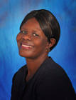
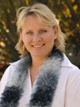
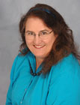
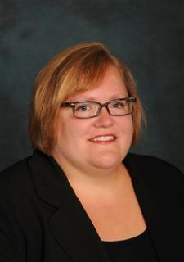
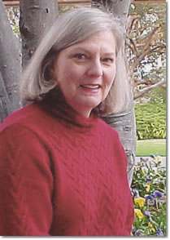
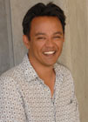
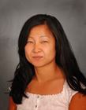
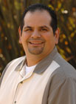
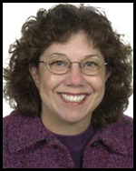
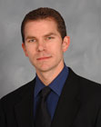
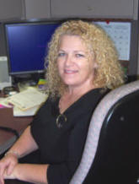
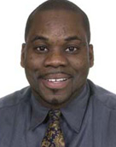
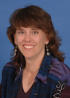
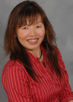
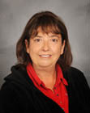
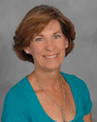
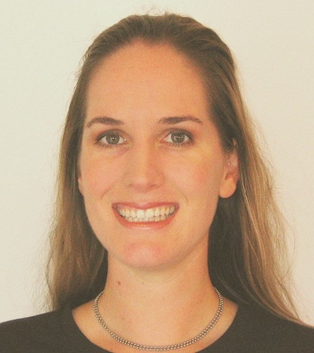
WHO WAS INVOLVED IN WRITING THE SELF EVALUATION REPORT?
Notes:
Barb end here

Slide 12
WHAT ARE THE NEXT STEPS?
Approximate Timeline
Spring 2013
Fall 2013
Final editing of the Self Evaluation (Jan-Feb)
Discussion of Self Evaluation by constituency groups and at forums (Mar-Apr)
Governing Board approval (May)
Submit Self Evaluation Report to ACCJC (June)
External Site Visit (October)

Slide 14
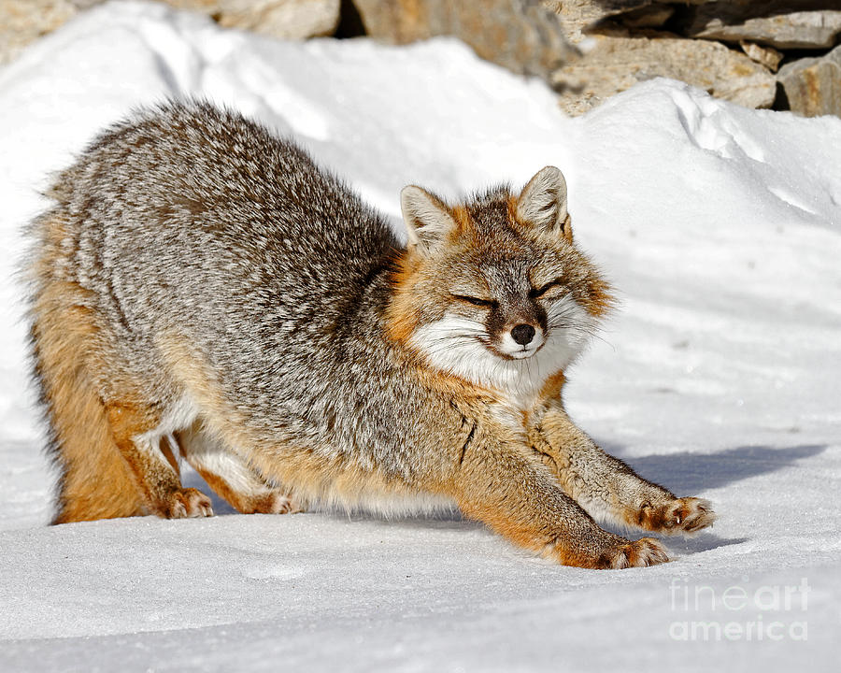
Stretch time!
Notes:
Jennifer DeMarco

Slide 15
Classified Staff Professional Development Updates

Slide 16
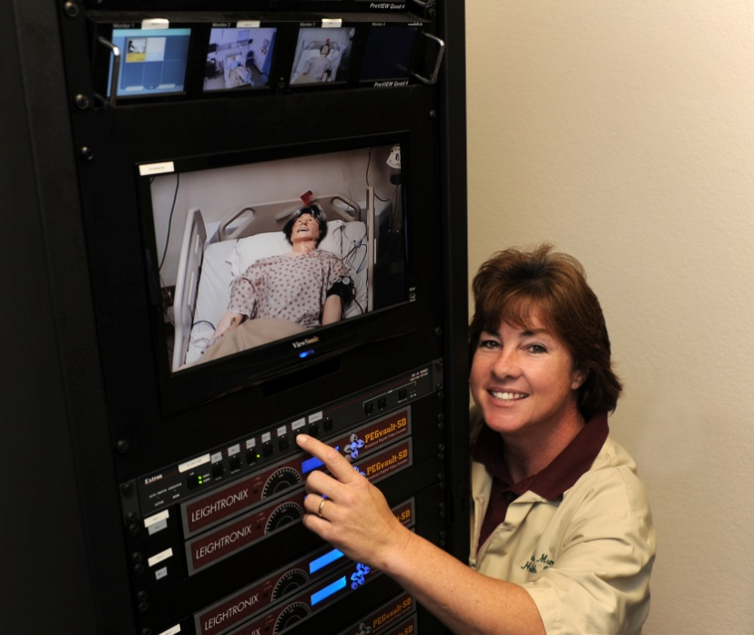
Introduction of Classified Staff Leadership
Pat Murray, Health Sciences Lab Technician

Slide 17
Classified Senate Leaders
Linda Daley
Vice President, Grossmont Council
Tom Fox
Member at Large

Slide 18
Classified Senate Leaders
Sharon Farley
Senator
Cindy Hall
Senator

Slide 19
Classified Senate Leaders
Patty Sparks
Senator
Mary Eden
Senator

Slide 20
Classified Union Leaders
Al Ventura CSEA 707 chapter job steward
Will Pines CSEA 707 chapter treasurer
Rocky Rose CSEA 707 chapter president Cuyamaca College

Slide 21
Introduction of Keynote Presentation

Slide 22
Have a great semester!
Thank you!
Notes:
Enjoy your semester

